Slide 1

Module 8: Data Storage Scaling

Slide 2
Identify the correct statement
Multiple EBS Volumes may be attached to the same EC2 instance
EC2 Instance Store(ephemeral volumes) are a local resource directly attached to the host that an EC2 instance runs in
Because of it is scalable and durable nature, S3 is a good candidate for hosting live database transaction log and data files
CloudFront supports caching of static objects as well RTMP and RTMPE streaming and HTTP progressive download
EBS volume have a maximum size of 2TB
Sequential IO is a better fit for EBS volumes compared to EC2 Instance Store(ephemeral volumes)
Frequent EBS snapshots increase EBS volume durability
Multiple EC2 instances with multiple EBS volumes can be pooled to create a multi-petabyte Distributed Network File System (DNFS)

Slide 3
Topics
Data storage options
Amazon EBS
Instance storage
Amazon S3
AWS Snowball
Amazon EFS
AWS Storage Gateway

Slide 4
Topics
Data storage options
AWS storage options
Best practices for data storage
Amazon EBS
Instance storage
Amazon S3
AWS Snowball
Amazon EFS
AWS Storage Gateway

Slide 5

AWS Storage Options
Block Storage: Instance Store, Amazon EBS
Object Storage: Amazon S3, Amazon Glacier, Amazon CloudFront
Sync Volumes: AWS Storage Gateway
Relational Databases: Amazon RDS
NoSQL Database: Amazon DynamoDB
In-memory Cache: ElastiCache
Content Cache: Amazon CloudFront

Slide 6
Best practices on choosing the right data storage solution
Understand the variety of storage options on AWS
Access performance, durability, cost, and interface
POSIX versus Object store-choose where appropriate
Use multiple cloud storage-storage hierarchy
Horizontal versus Vertical scaling
Be creative. Use storage alternatives like in-memory caches
It’s all about performance-oriented and cost-oriented choice.

Slide 7
Topics
Data storage options
Amazon Elastic Block Storage(EBS)
Benefits of using Amazon EBS
Standard volumes versus Provisioned IPOPS volumes
Amazon EBS pricing
Instance storage
Amazon S3
AWS Snowball
Amazon EFS
AWS Storage Gateway

Slide 8
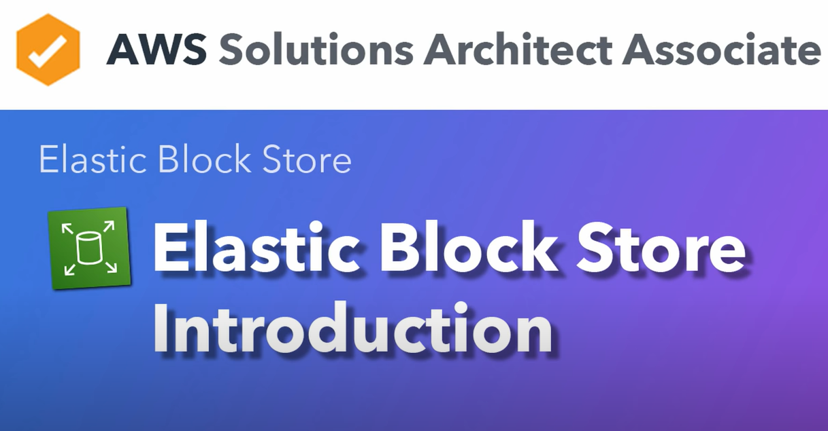

Slide 9
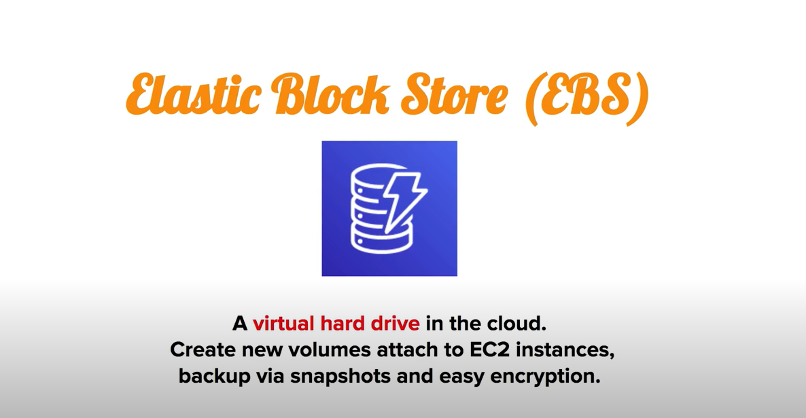

Slide 10
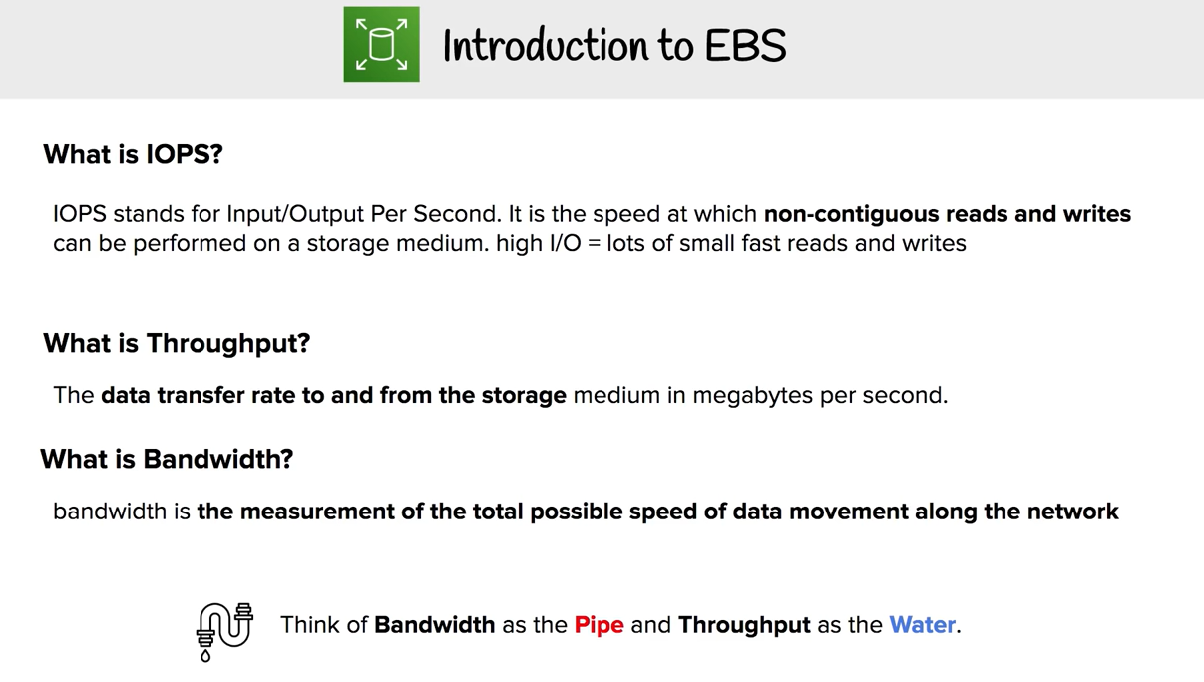

Slide 11
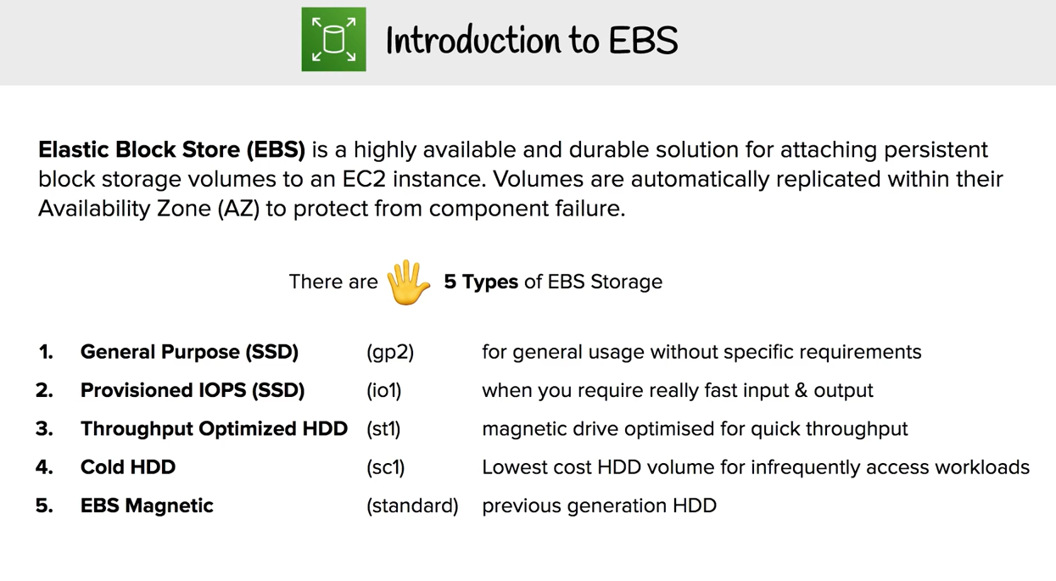

Slide 12
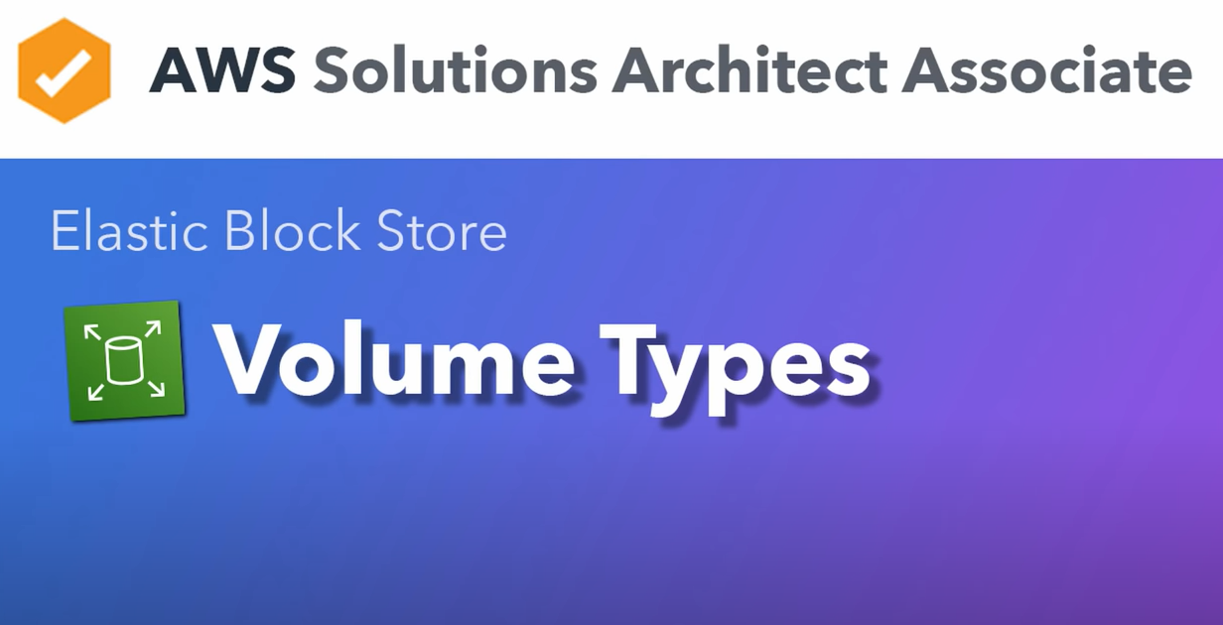

Slide 13
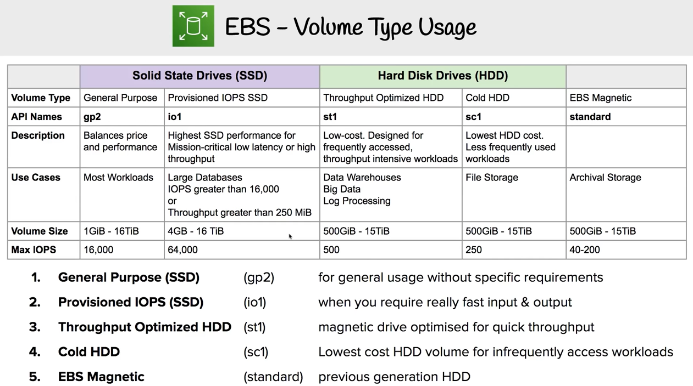

Slide 14
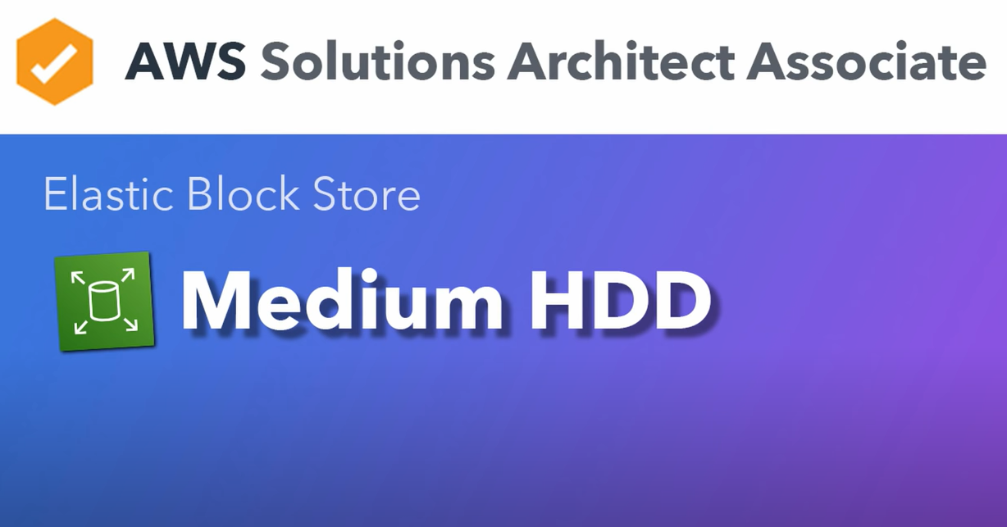

Slide 15
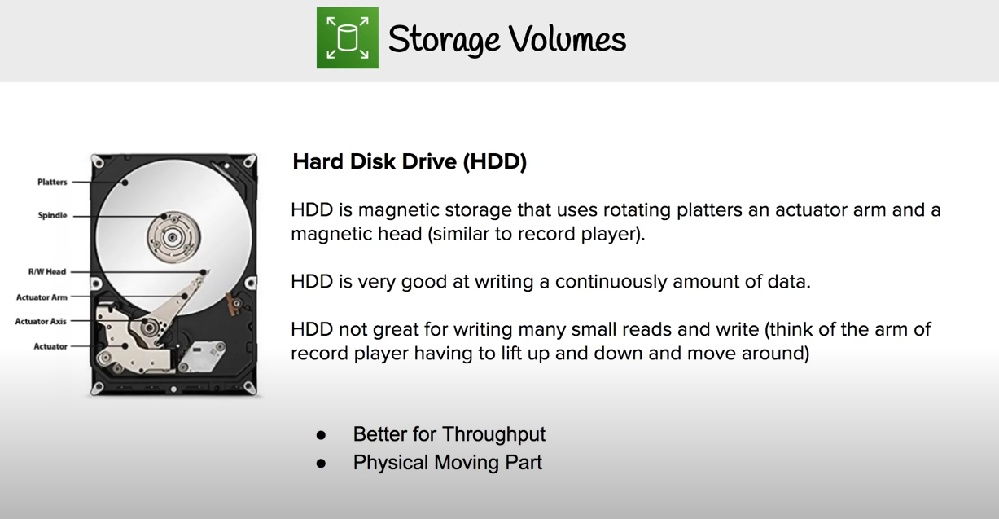

Slide 16
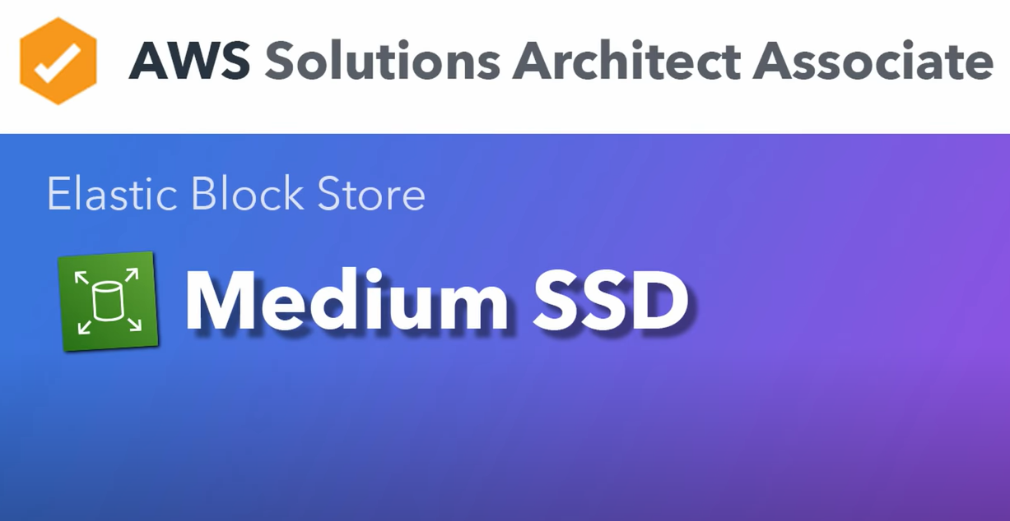

Slide 17
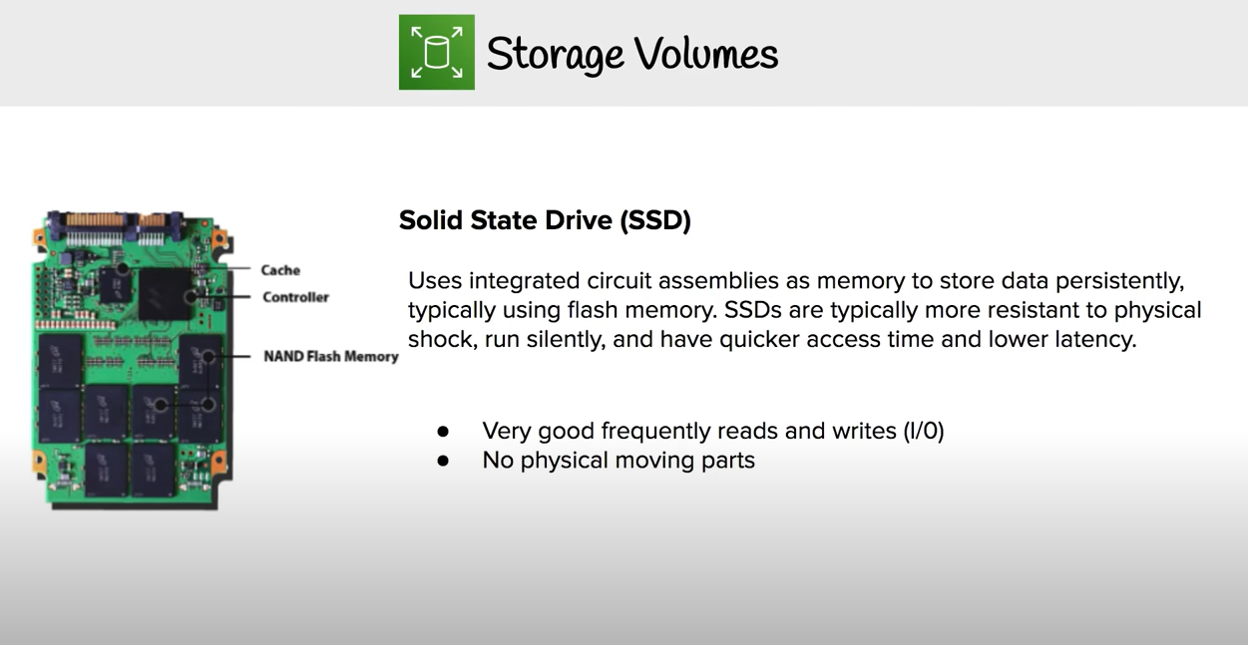

Slide 18
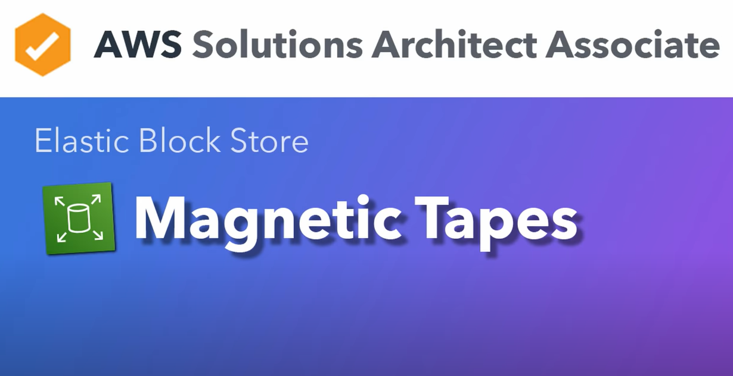

Slide 19
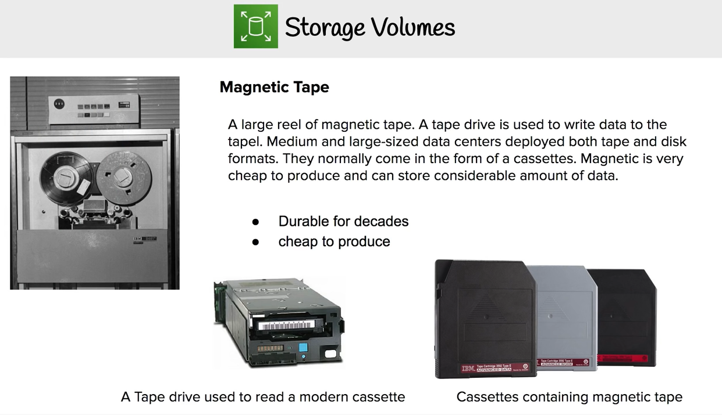

Slide 20
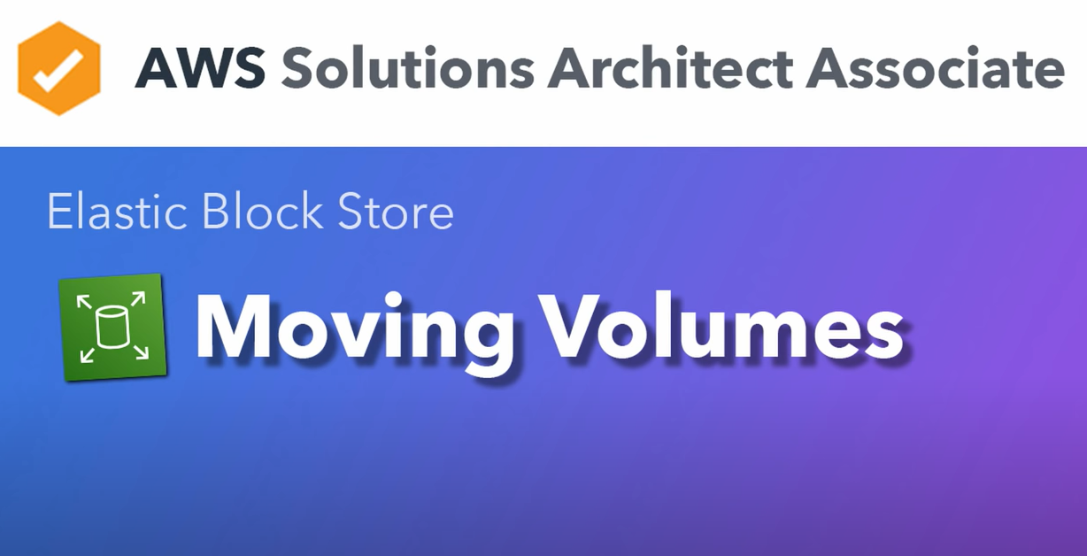

Slide 21
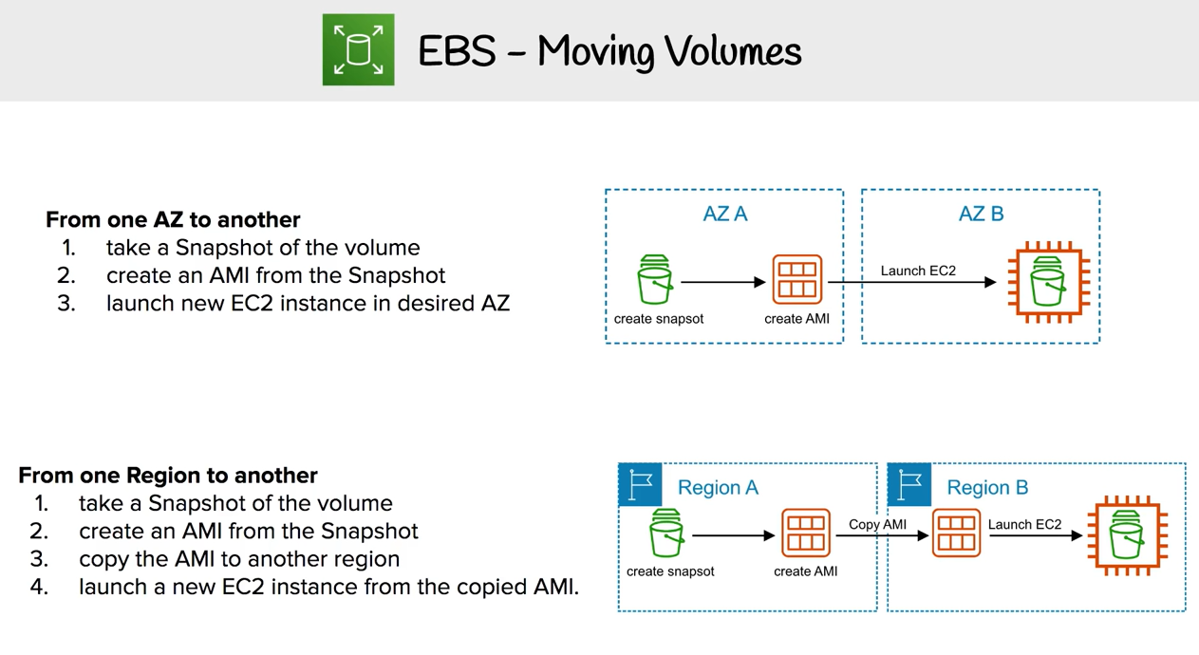

Slide 22
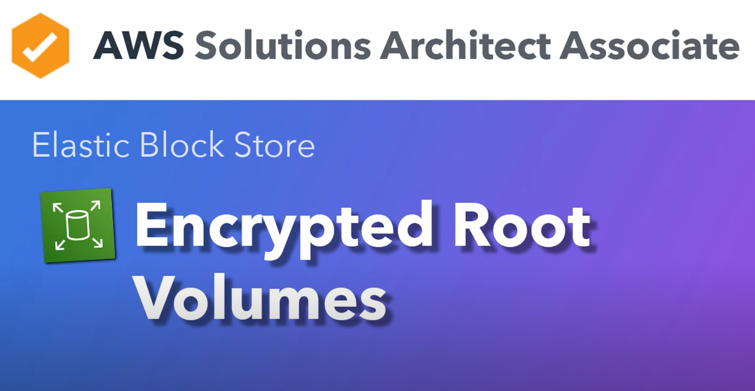

Slide 23
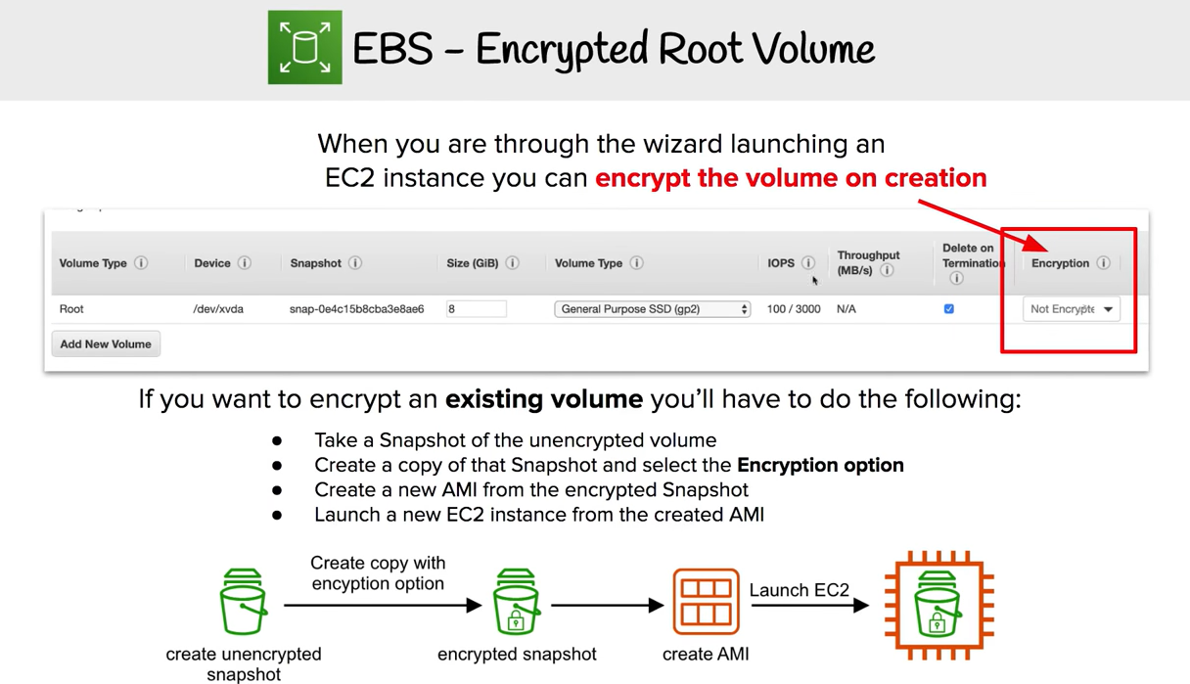

Slide 24
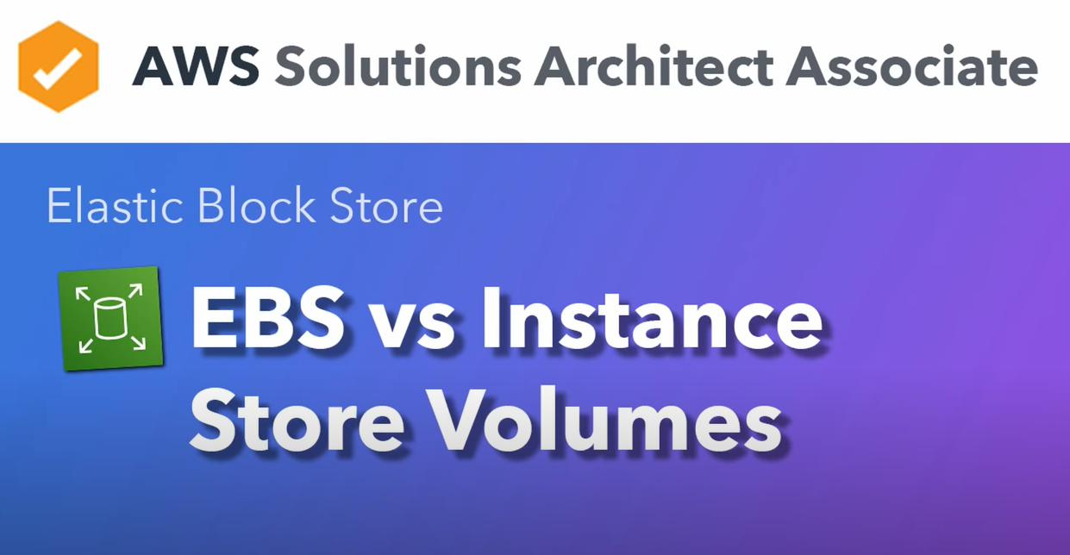

Slide 25
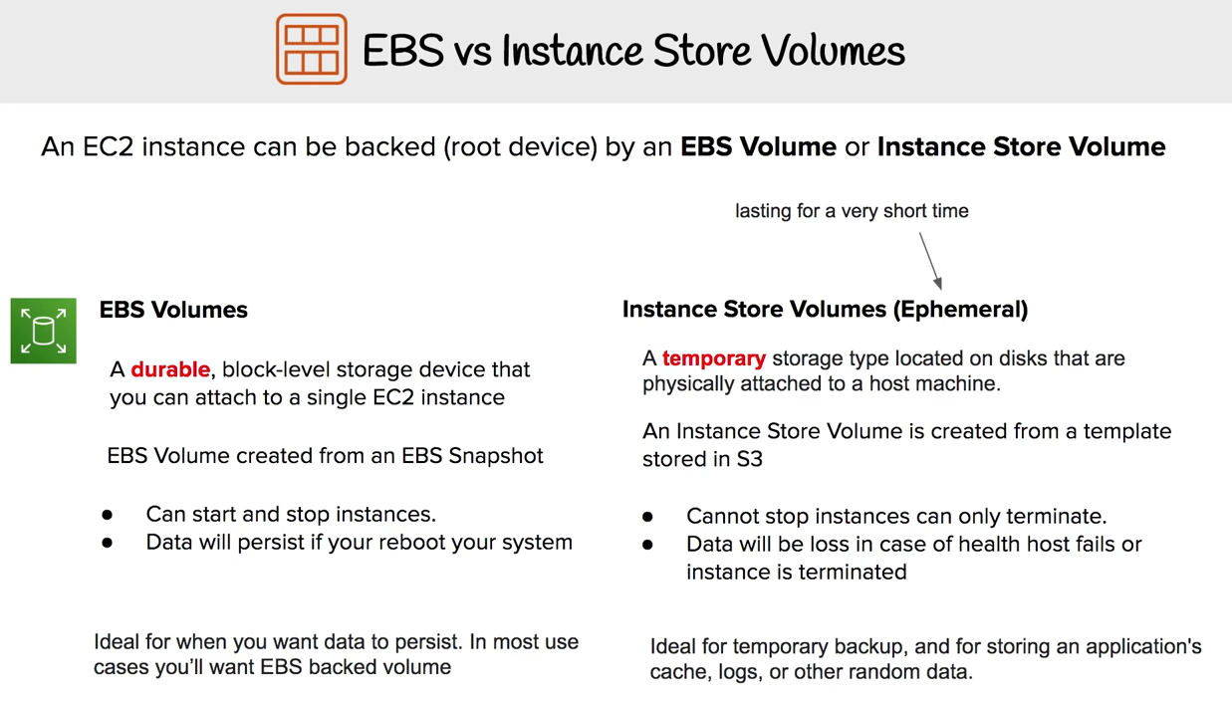

Slide 26
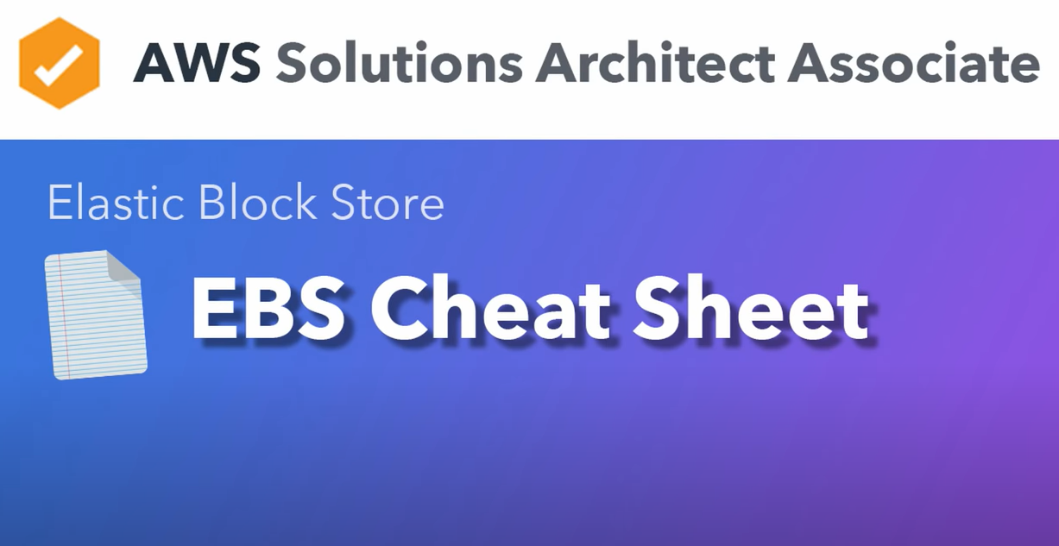

Slide 27
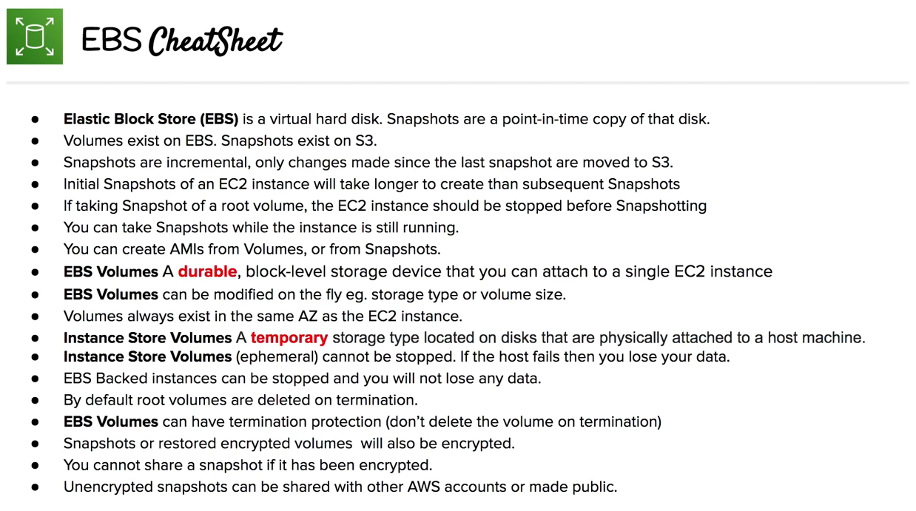

Slide 28
Topics
Data storage options
Amazon Elastic Block Storage (EBS)
Instance storage
Benefits of Amazon Instance Store
Instance Store Best Practices
Amazon S3 and Amazon CloudFront

Slide 29
Instance Store (1 of 3)
No additional charge beyond your Amazon EC2 Instance
Number and size of volumes varies by Amazon EC2 instance type
Larger instances have larger/more volumes
Hi1.4xlarge=2x1024GB SSD
C1.xlarge=4x450GB
T1.micro=none
Not automatically attached; Must request at instance launch
Volatile
No persistence
Data is gone when an Amazon EC2 instance stops, fails or is terminated

Slide 30
Instance Store (2 of 3)
Zero network overhead; local, direct attached resource
No network variability
Not optimized for random I/O
Generally better for sequential I/O
Root volume and data volume are lost on physical disk failure, stopping, or terminating of instance
Ideal for storing temporary data like buffers, caches, scratch data, and other temporary content, or for data that is replicated across a fleet of instances, such as a load-balanced pool of web servers

Slide 31
Instance Store (3 of 3)
High-performance SSD option
H1.4xlarge EC2 instance type
(2) x 1TB SSD local to instance
~120,000 random read IOPS (4 KB blocks)
~10,000-85,000 random write IOPS(4 KB blocks)
High-storage
Hs1.8xlarge EC2 instance type
(24) x 2TB disks local to instance = 48 TiB

Slide 32
Instance Store Anti-Patterns
Persistent storage
Consider Amazon EBS
Database/ Structure Storage
Consider Amazon RDS, DynamoDB, and so on
Shareable storage
Local instance storage volumes cannot be shared
Consider Amazon EBS
Backups
Consider Amazon EBS and Amazon Snapshots

Slide 33
Instance Store Review Questions
Describe benefits of Amazon Instance Store
Describe best practices of using Instance Store

Slide 34
Topics
Data storage options
Amazon Elastic Block Storage (EBS)
Instance storage
Amazon S3
AWS Snowball
Amazon EFS
AWS Storage Gateway

Slide 35
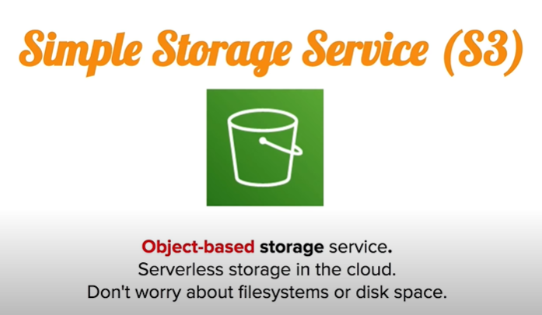

Slide 36
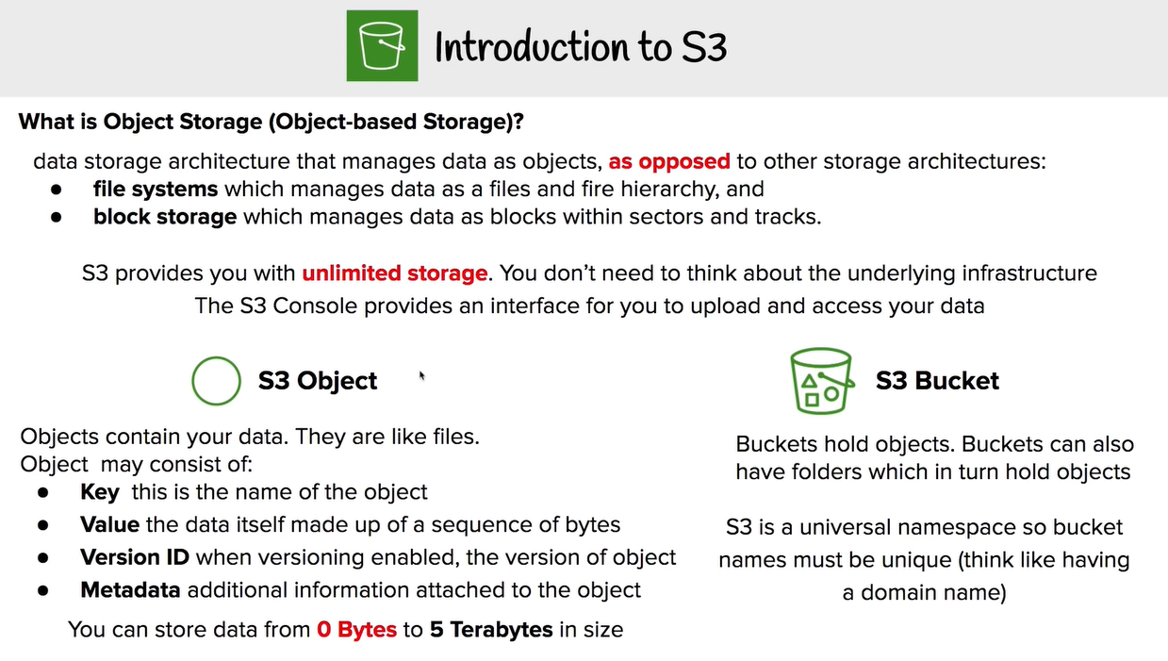

Slide 37
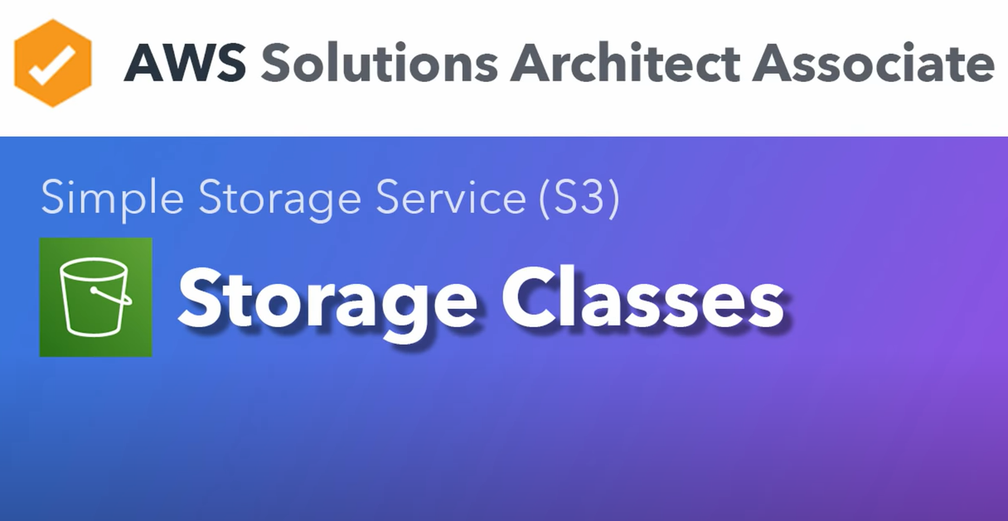

Slide 38
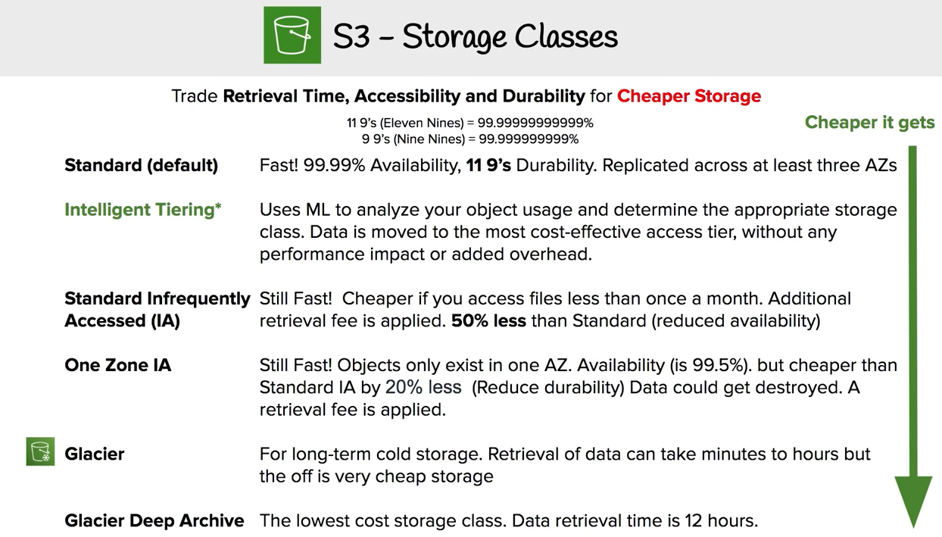

Slide 39
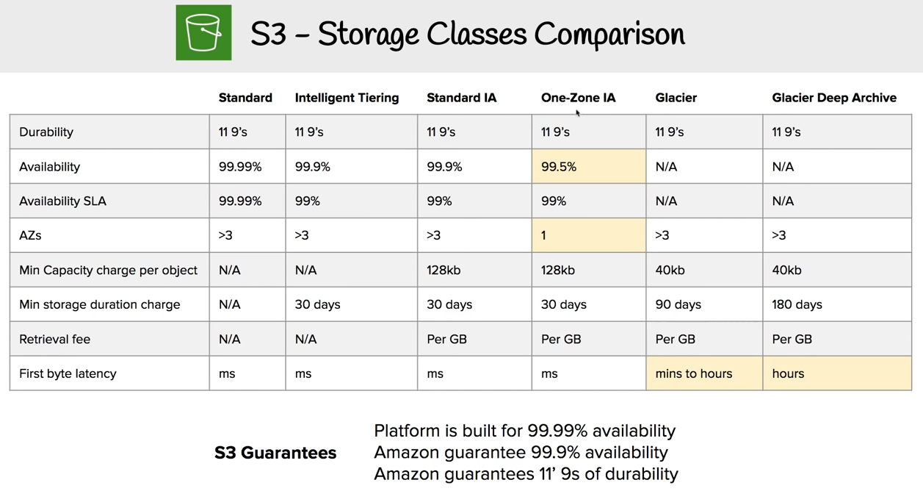

Slide 40
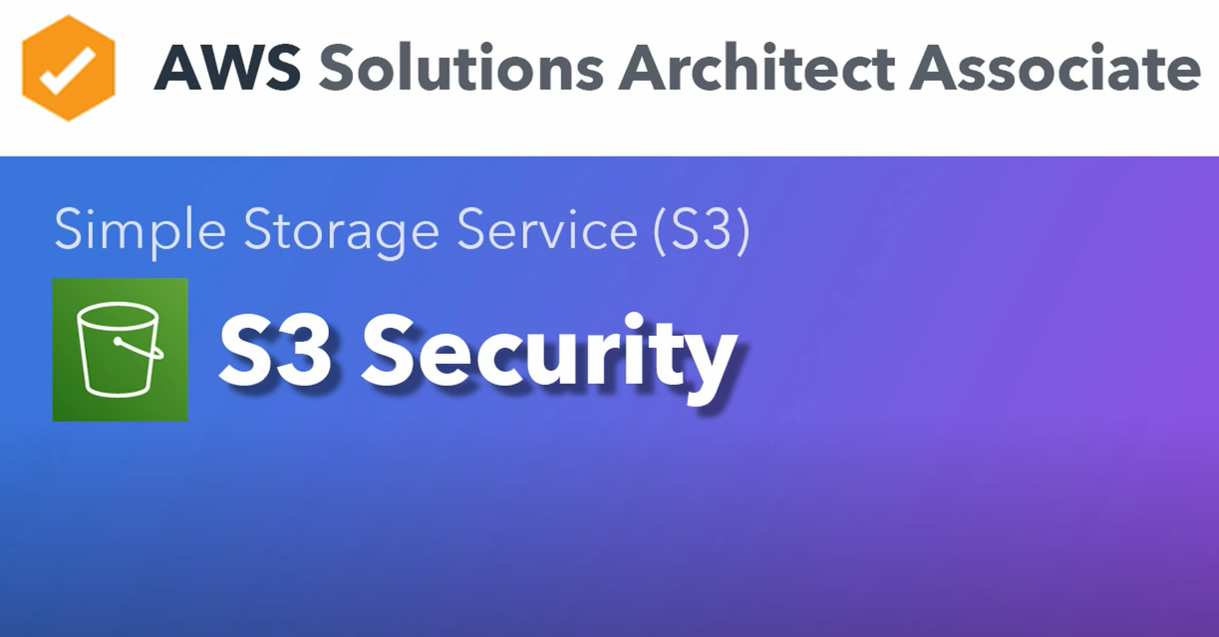

Slide 41
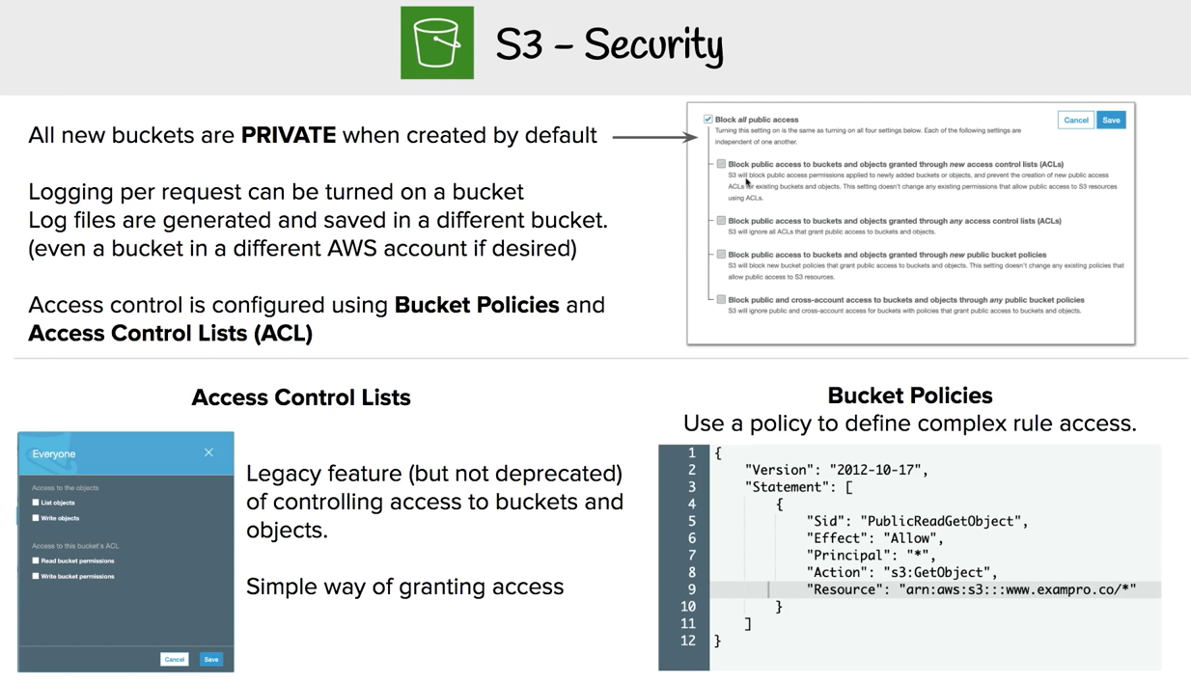

Slide 42
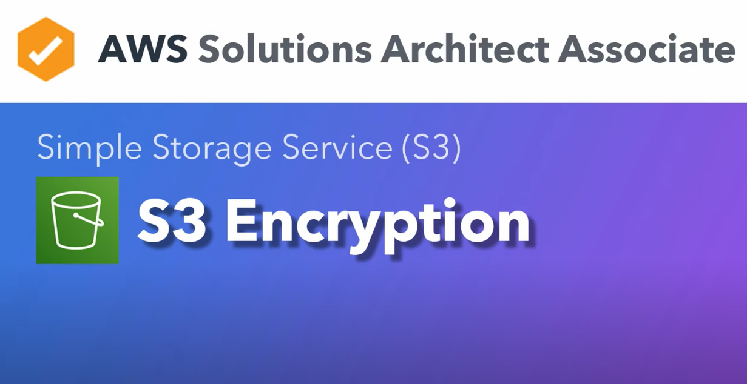

Slide 43
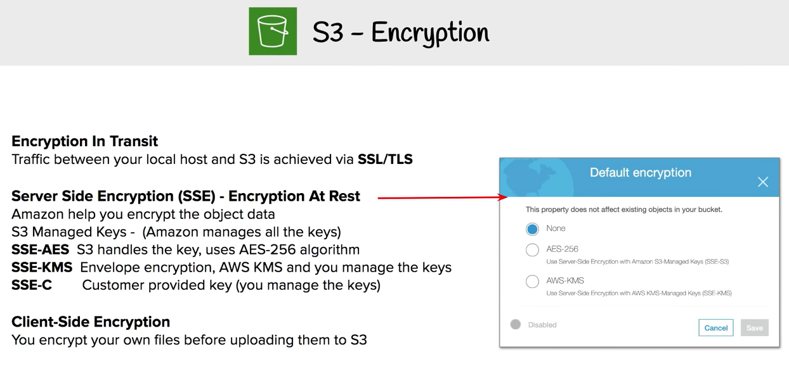

Slide 44
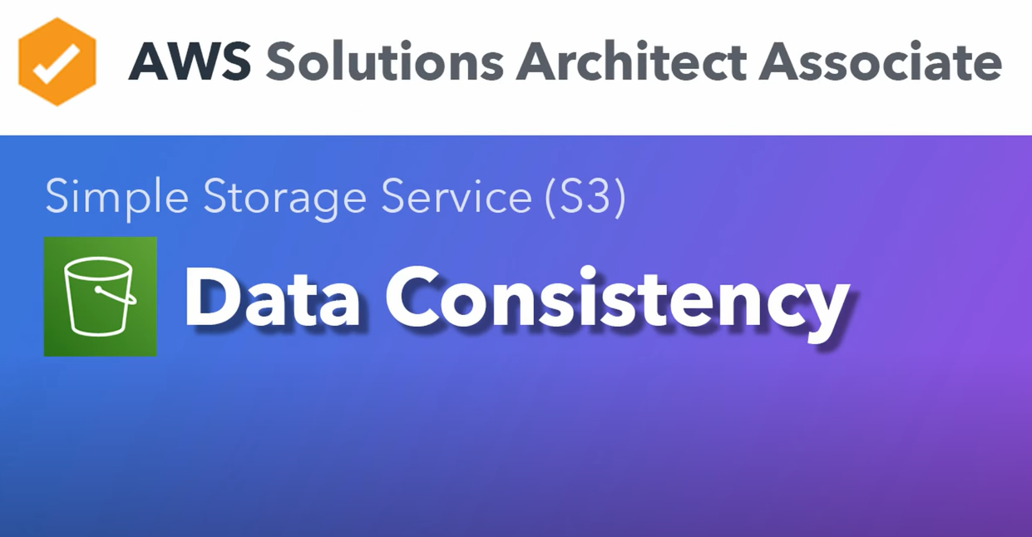

Slide 45
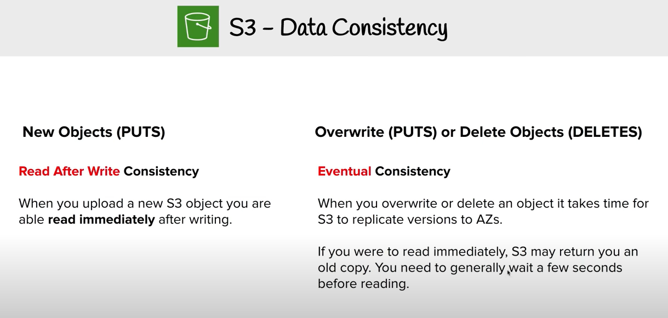

Slide 46
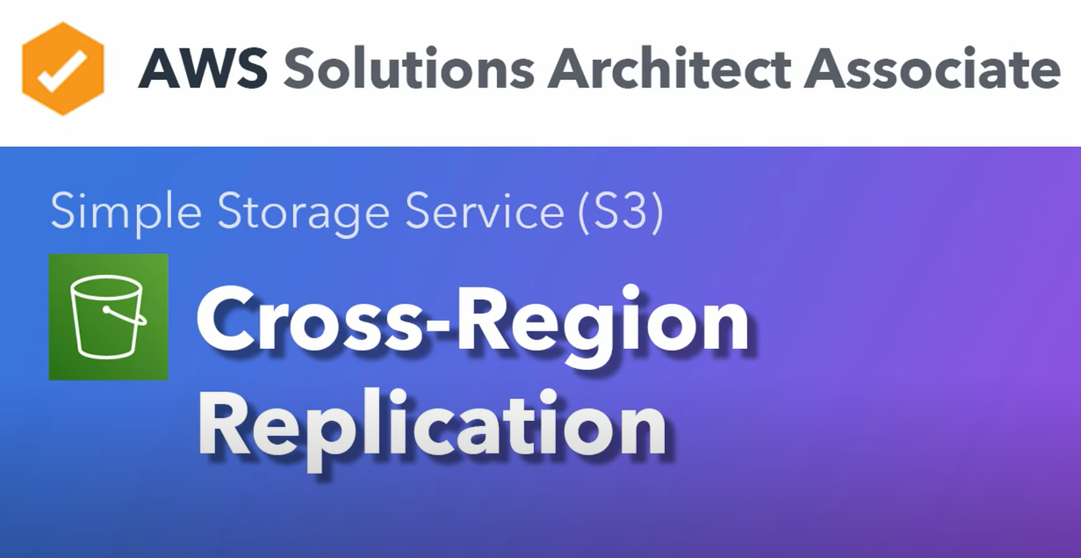

Slide 47
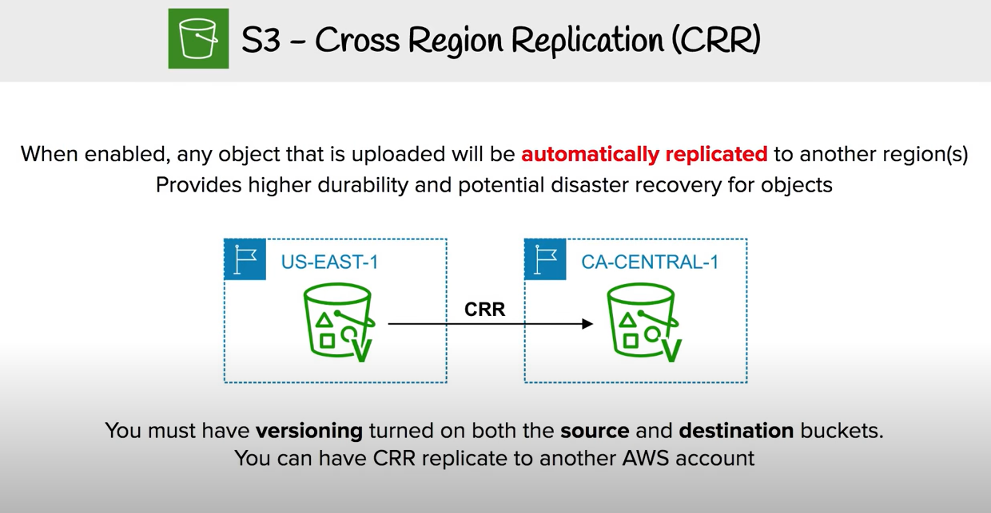

Slide 48
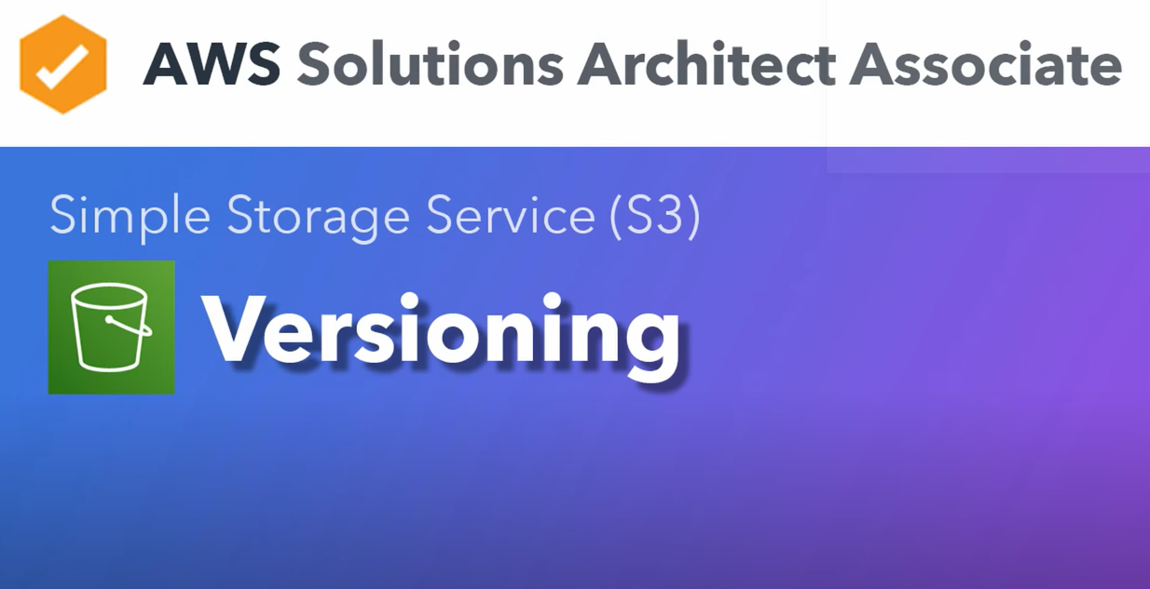

Slide 49
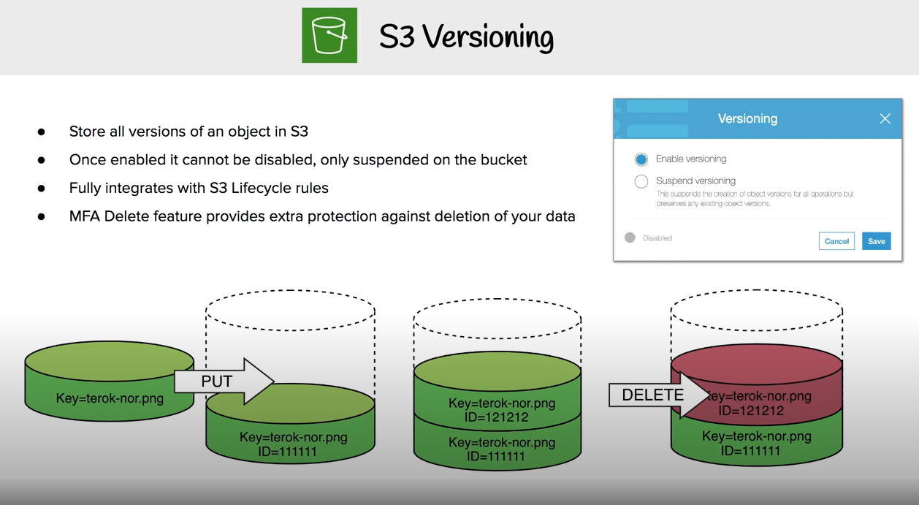

Slide 50
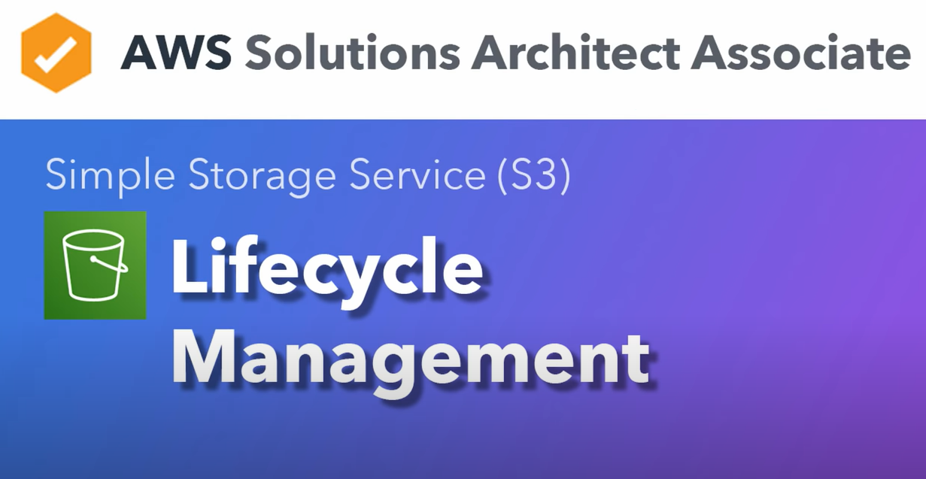

Slide 51
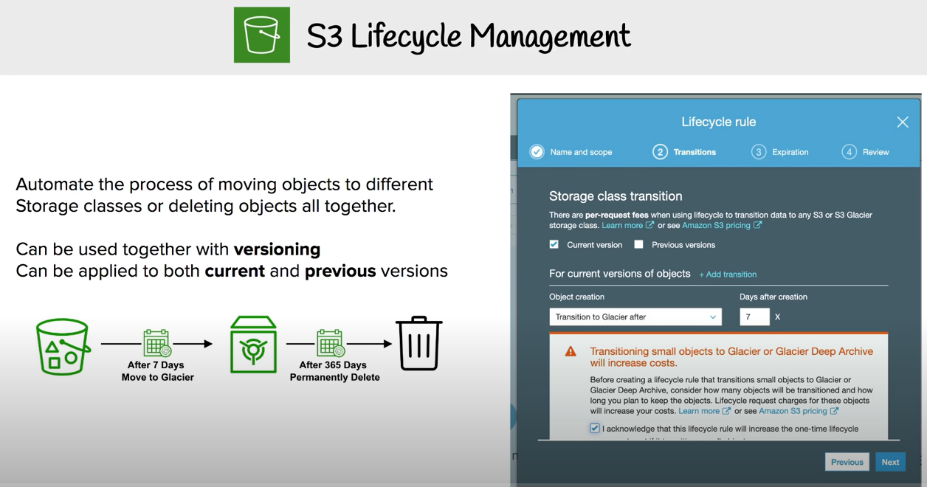

Slide 52
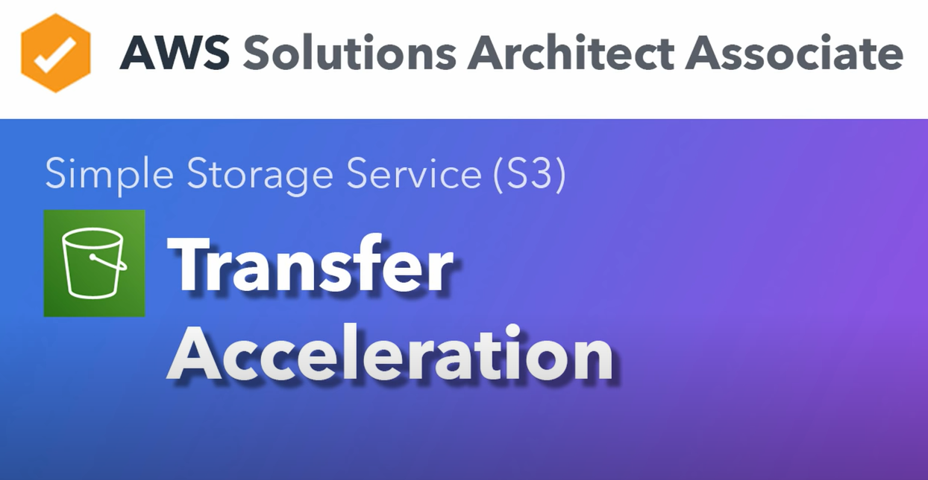

Slide 53
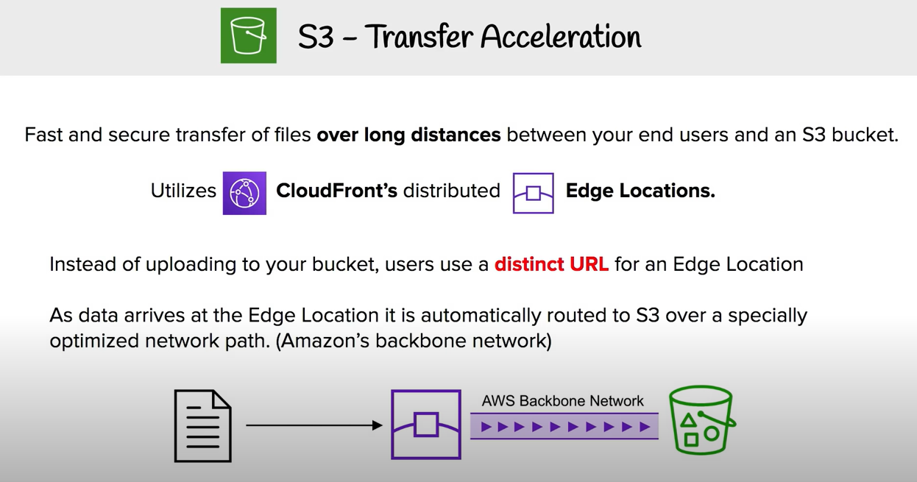

Slide 54
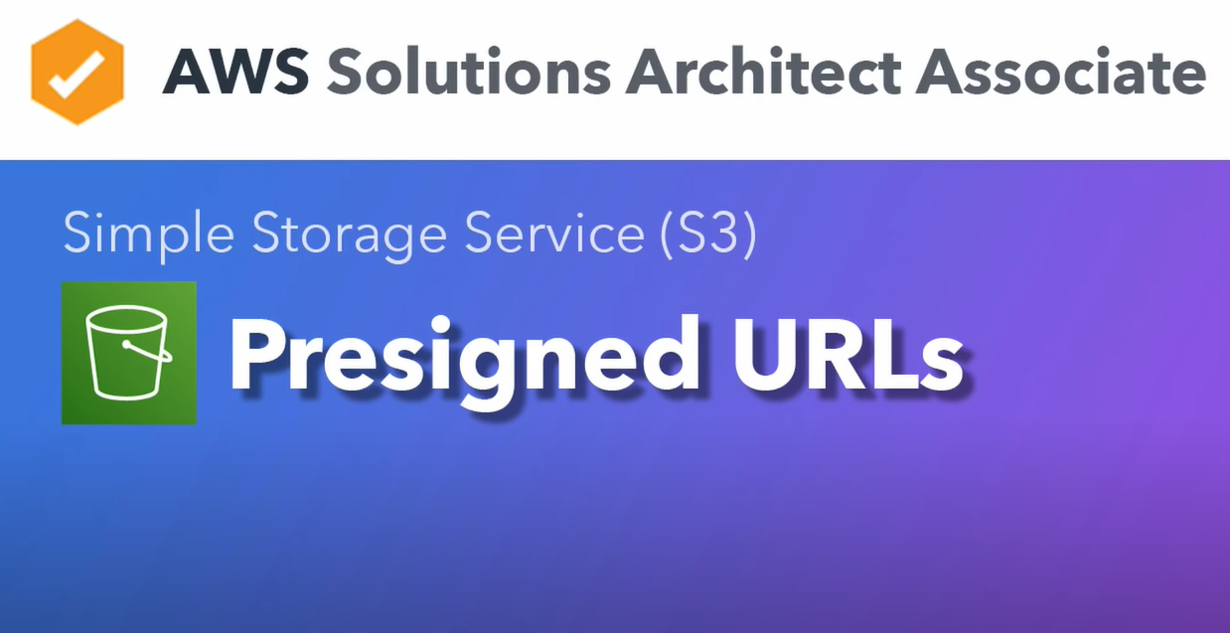

Slide 55
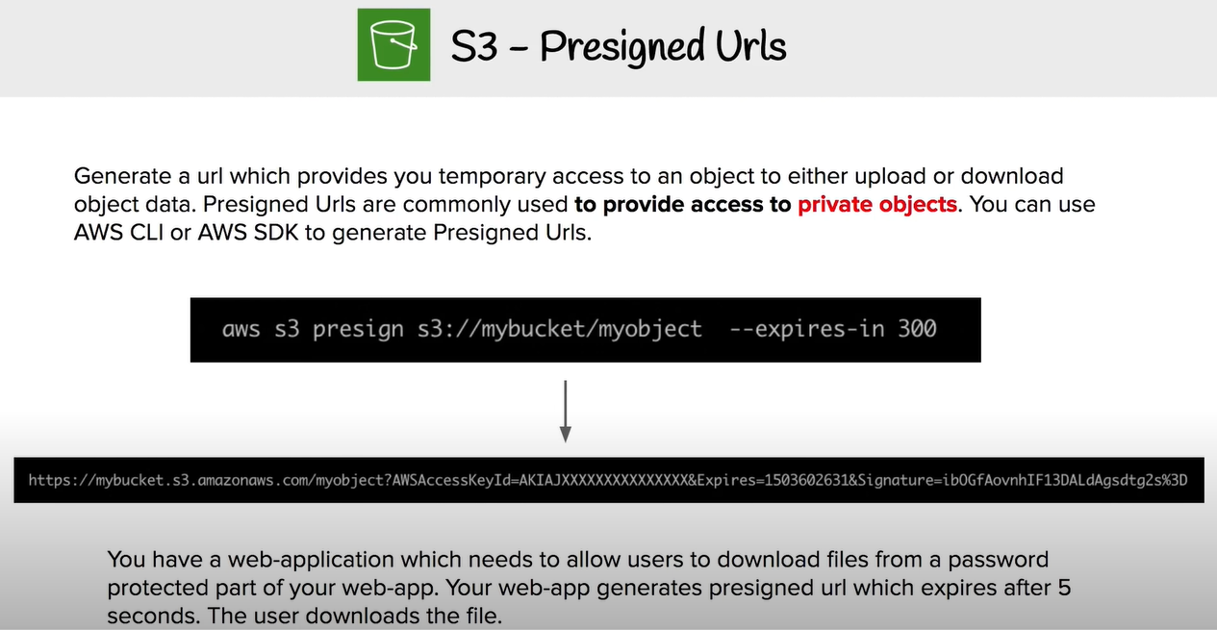

Slide 56
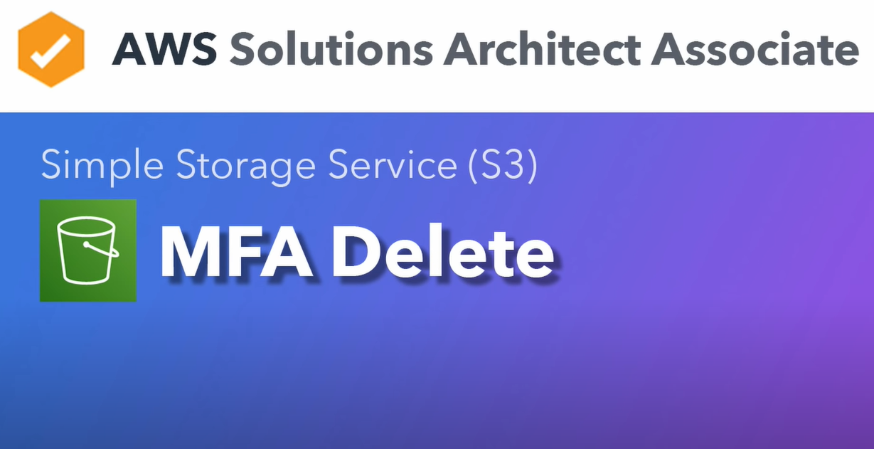

Slide 57
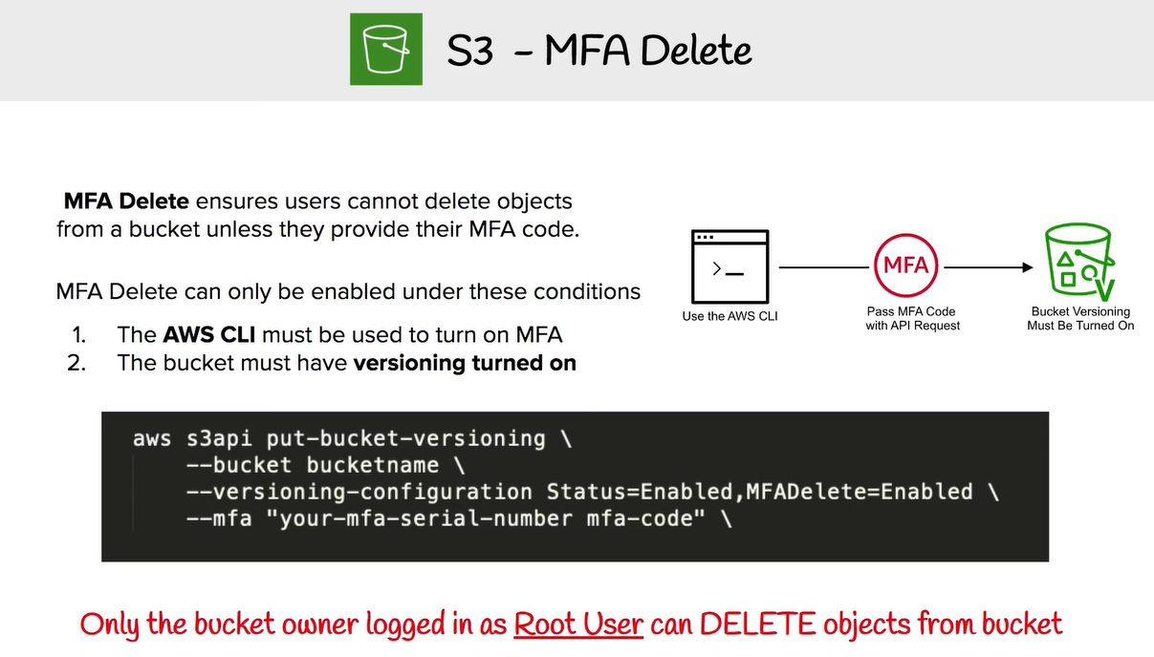

Slide 58

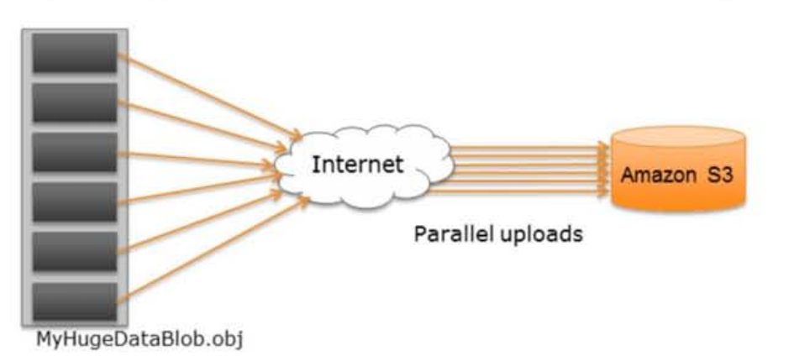
Multipart Upload
Upload as 100MB per part
Multipart Upload supports a maximum of 10,000 parts

Slide 59
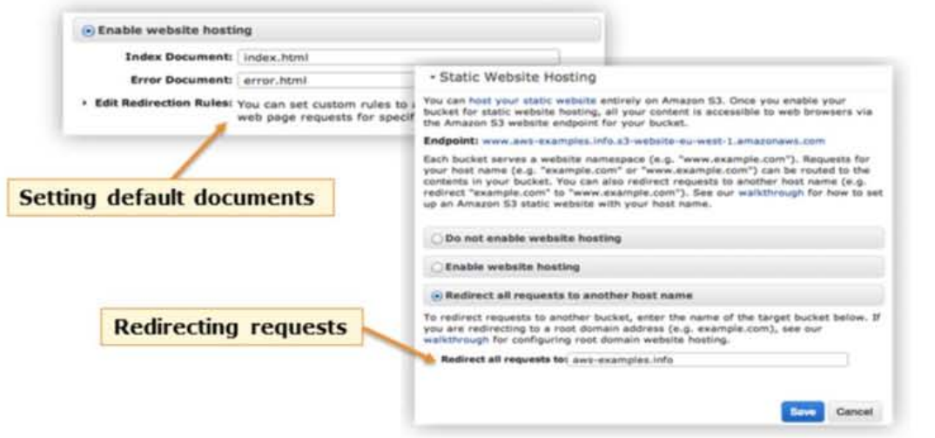
Website hosting using Amazon S3
Static sites with client-side scripts

Slide 60
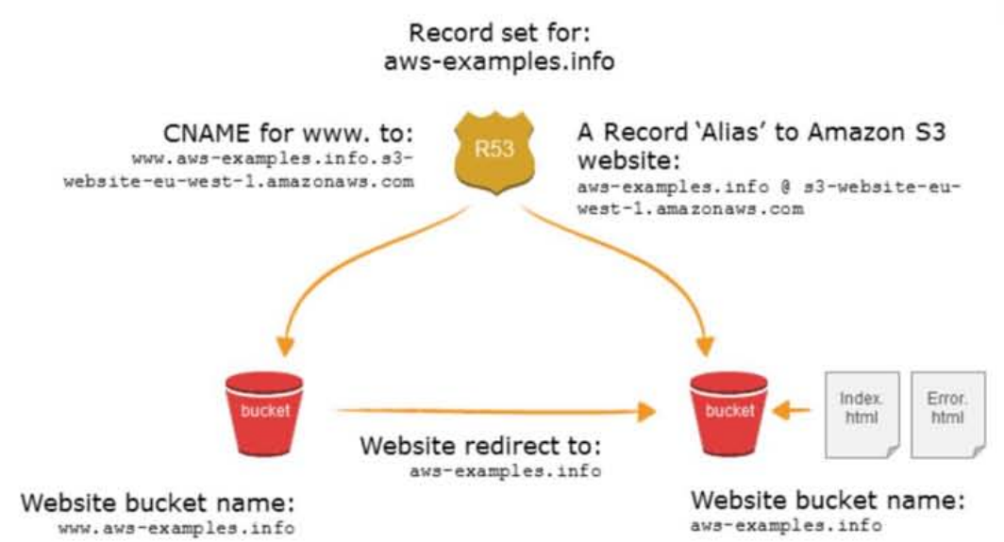
Website hosting using Amazon S3 (continue)

Slide 61
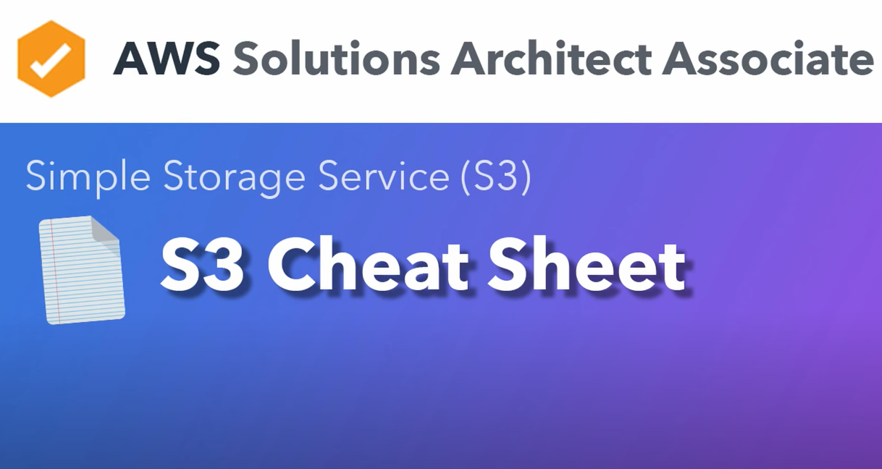

Slide 62
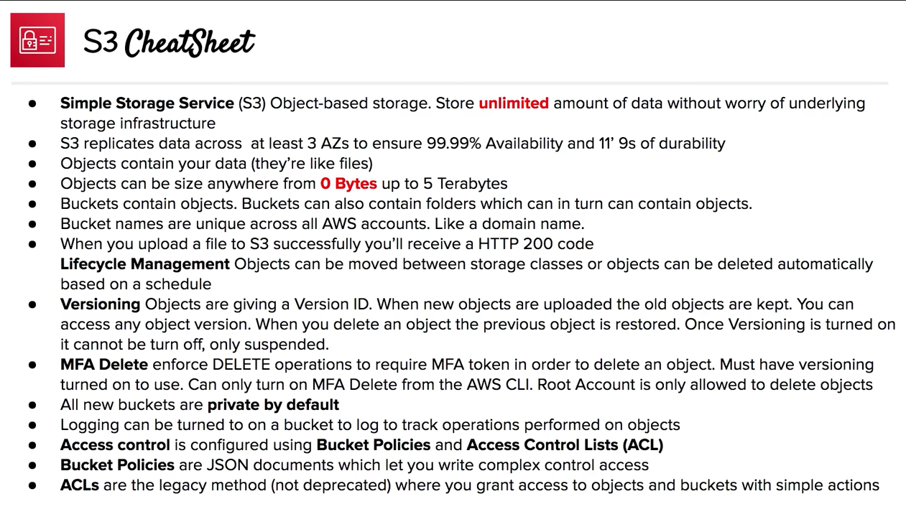

Slide 63
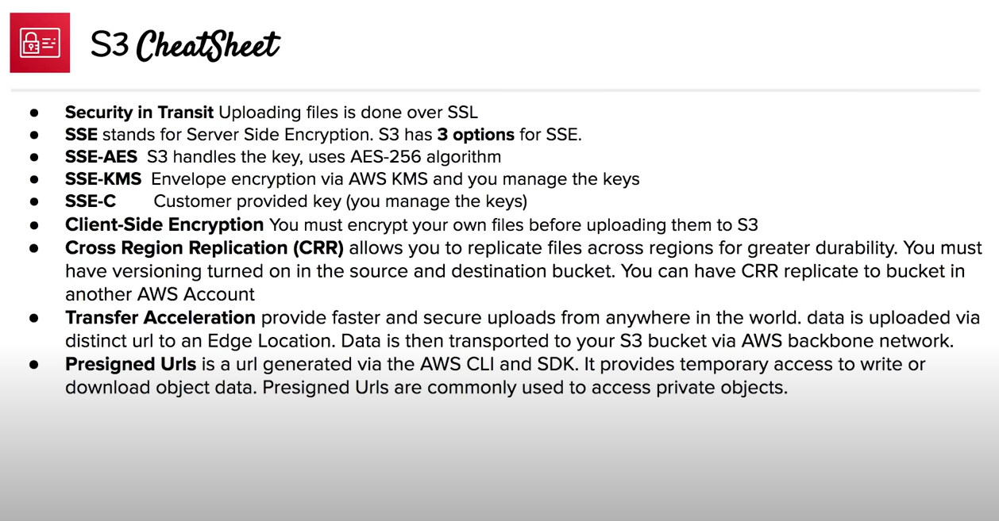

Slide 64
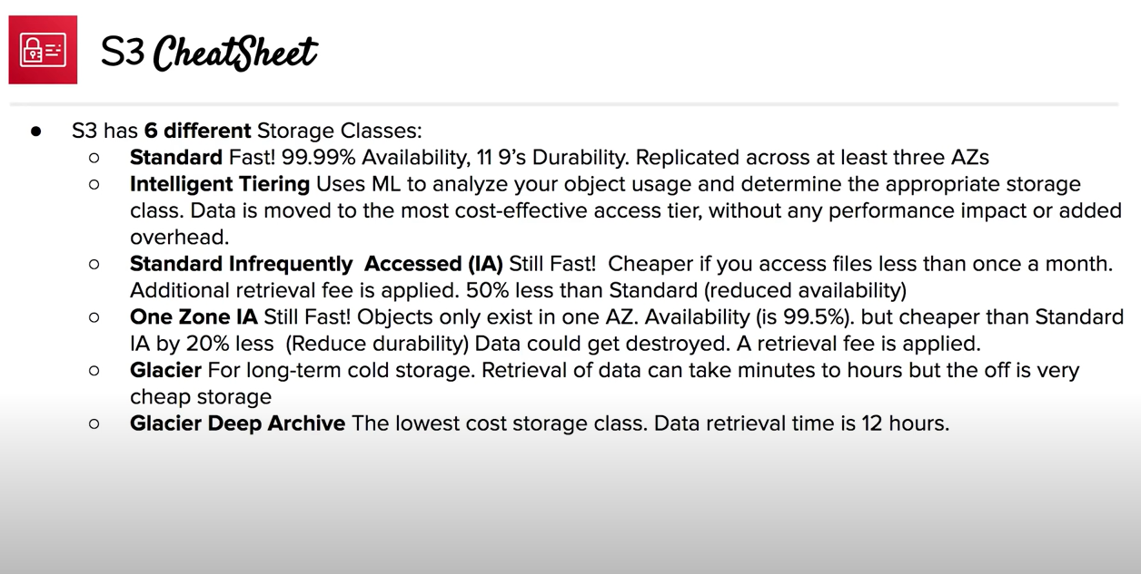

Slide 65


Slide 66


Slide 67


Slide 68


Slide 69


Slide 70


Slide 71


Slide 72


Slide 73


Slide 74


Slide 75


Slide 76


Slide 77


Slide 78


Slide 79


Slide 80


Slide 81


Slide 82


Slide 83


Slide 84


Slide 85


Slide 86


Slide 87


Slide 88


